Slide 1
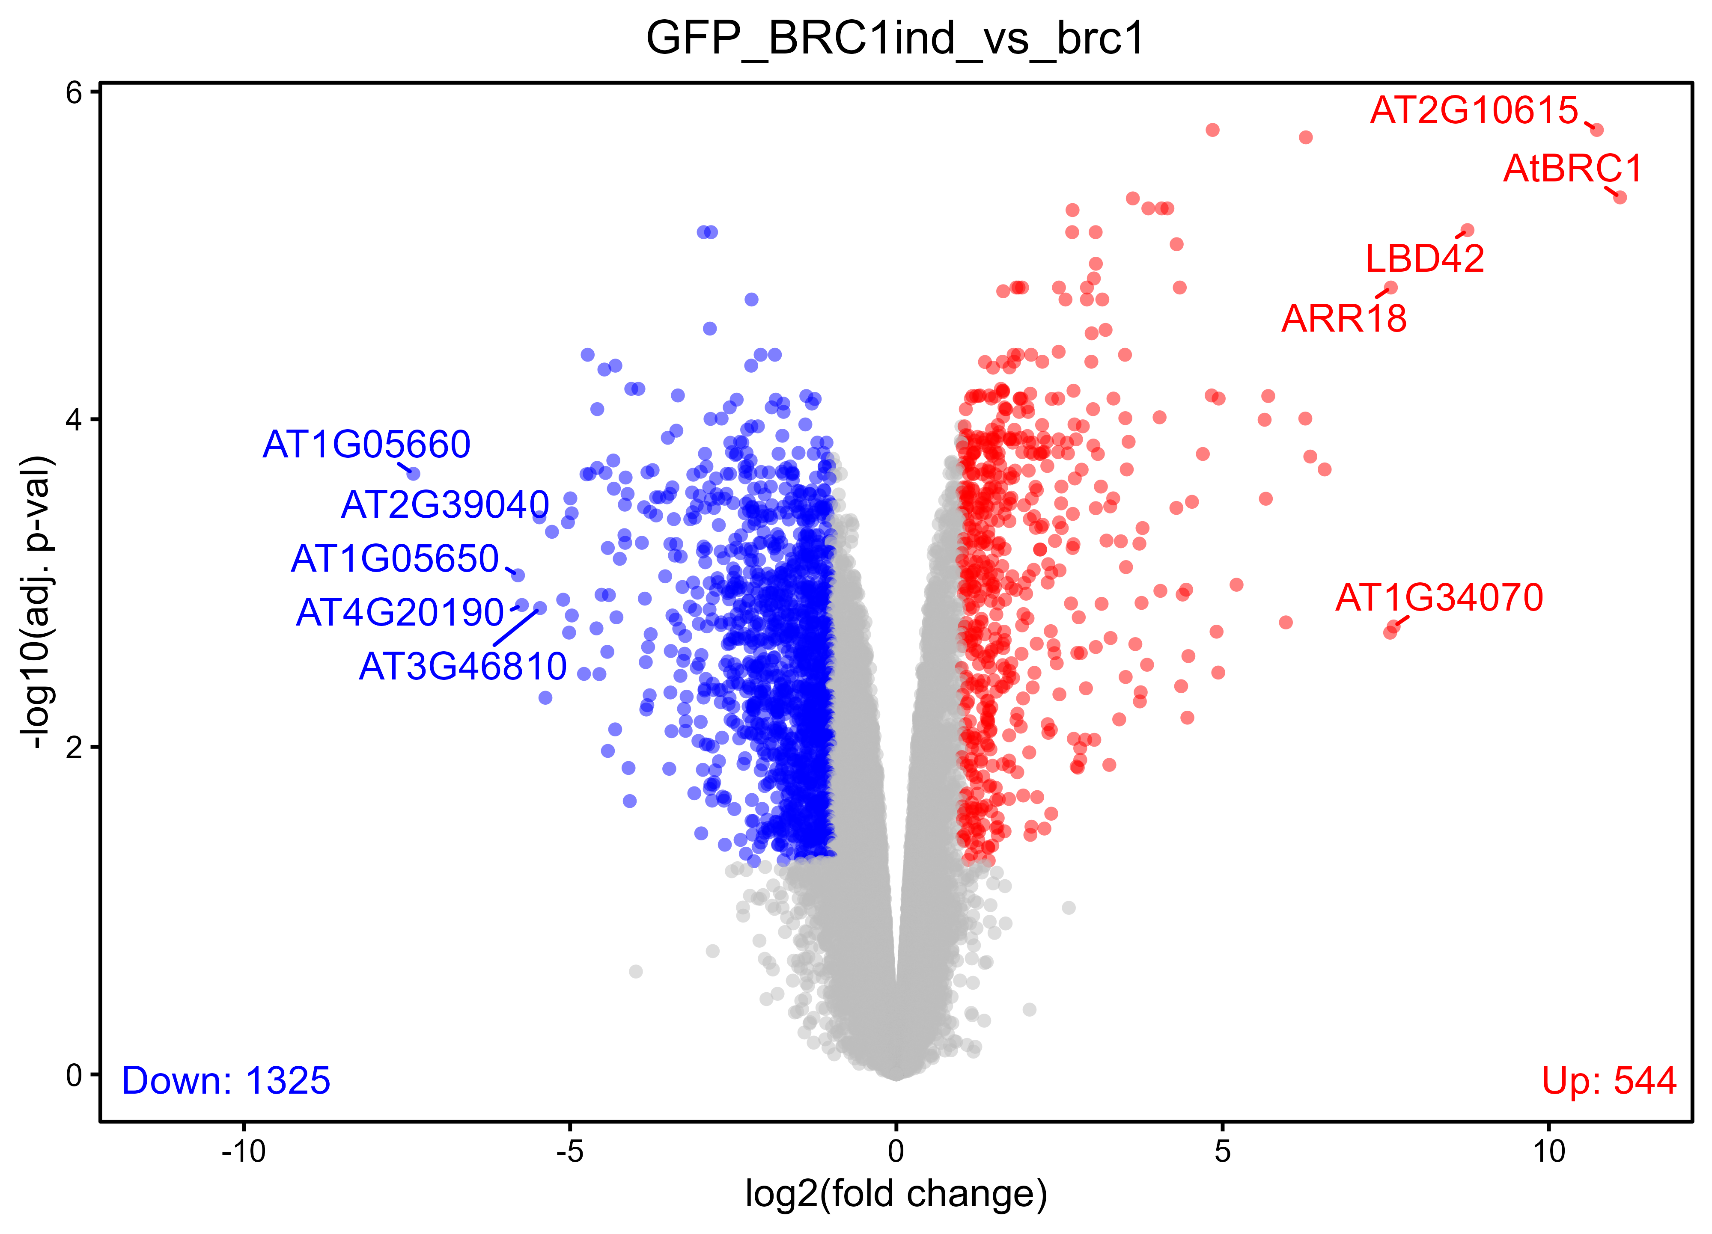
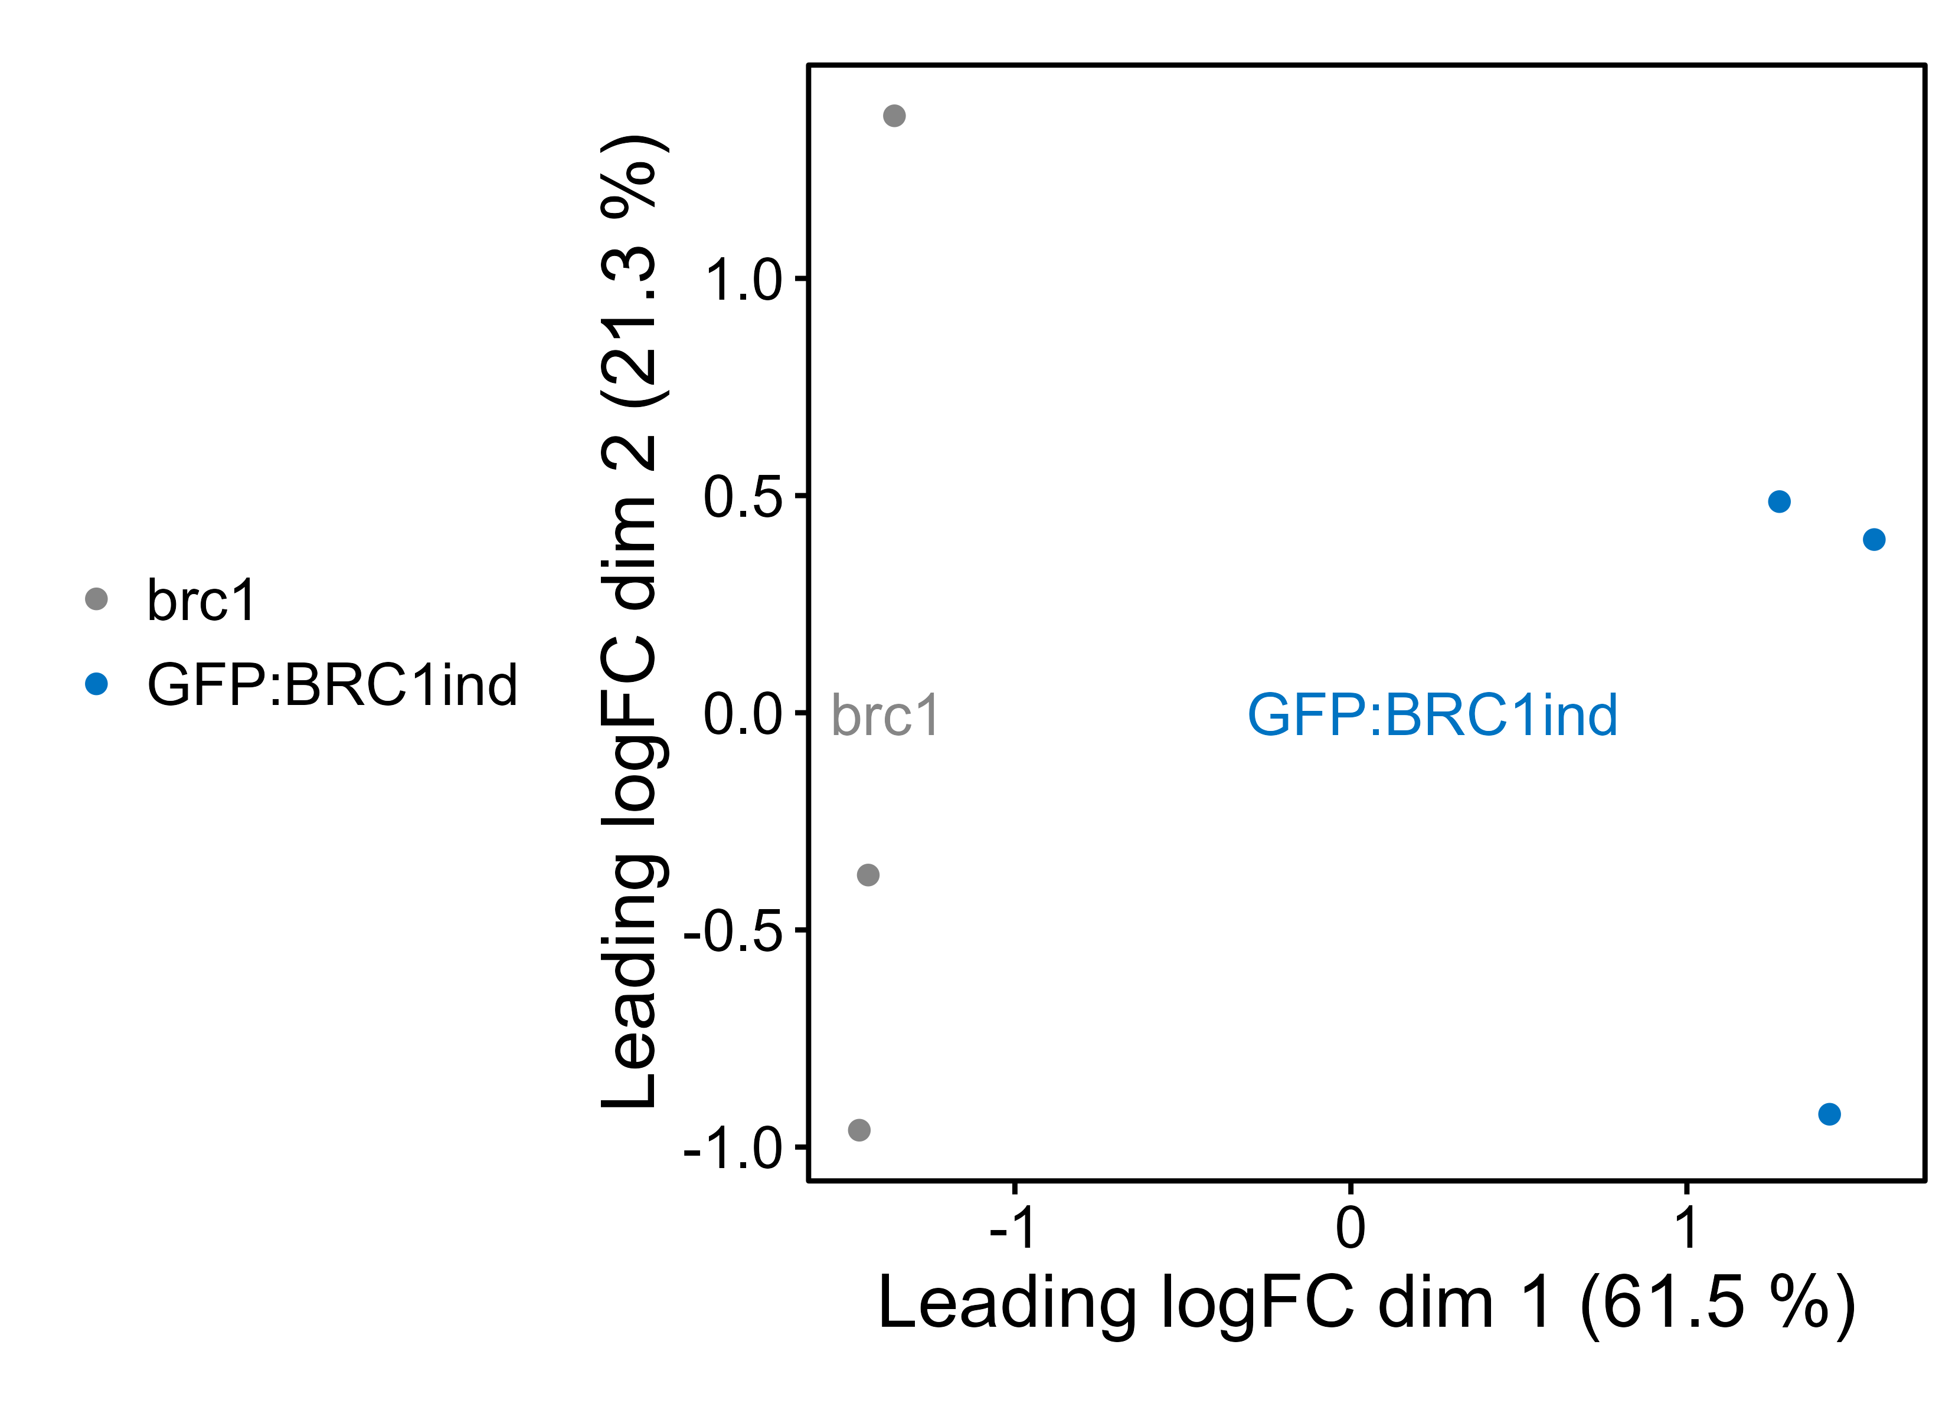

Slide 2
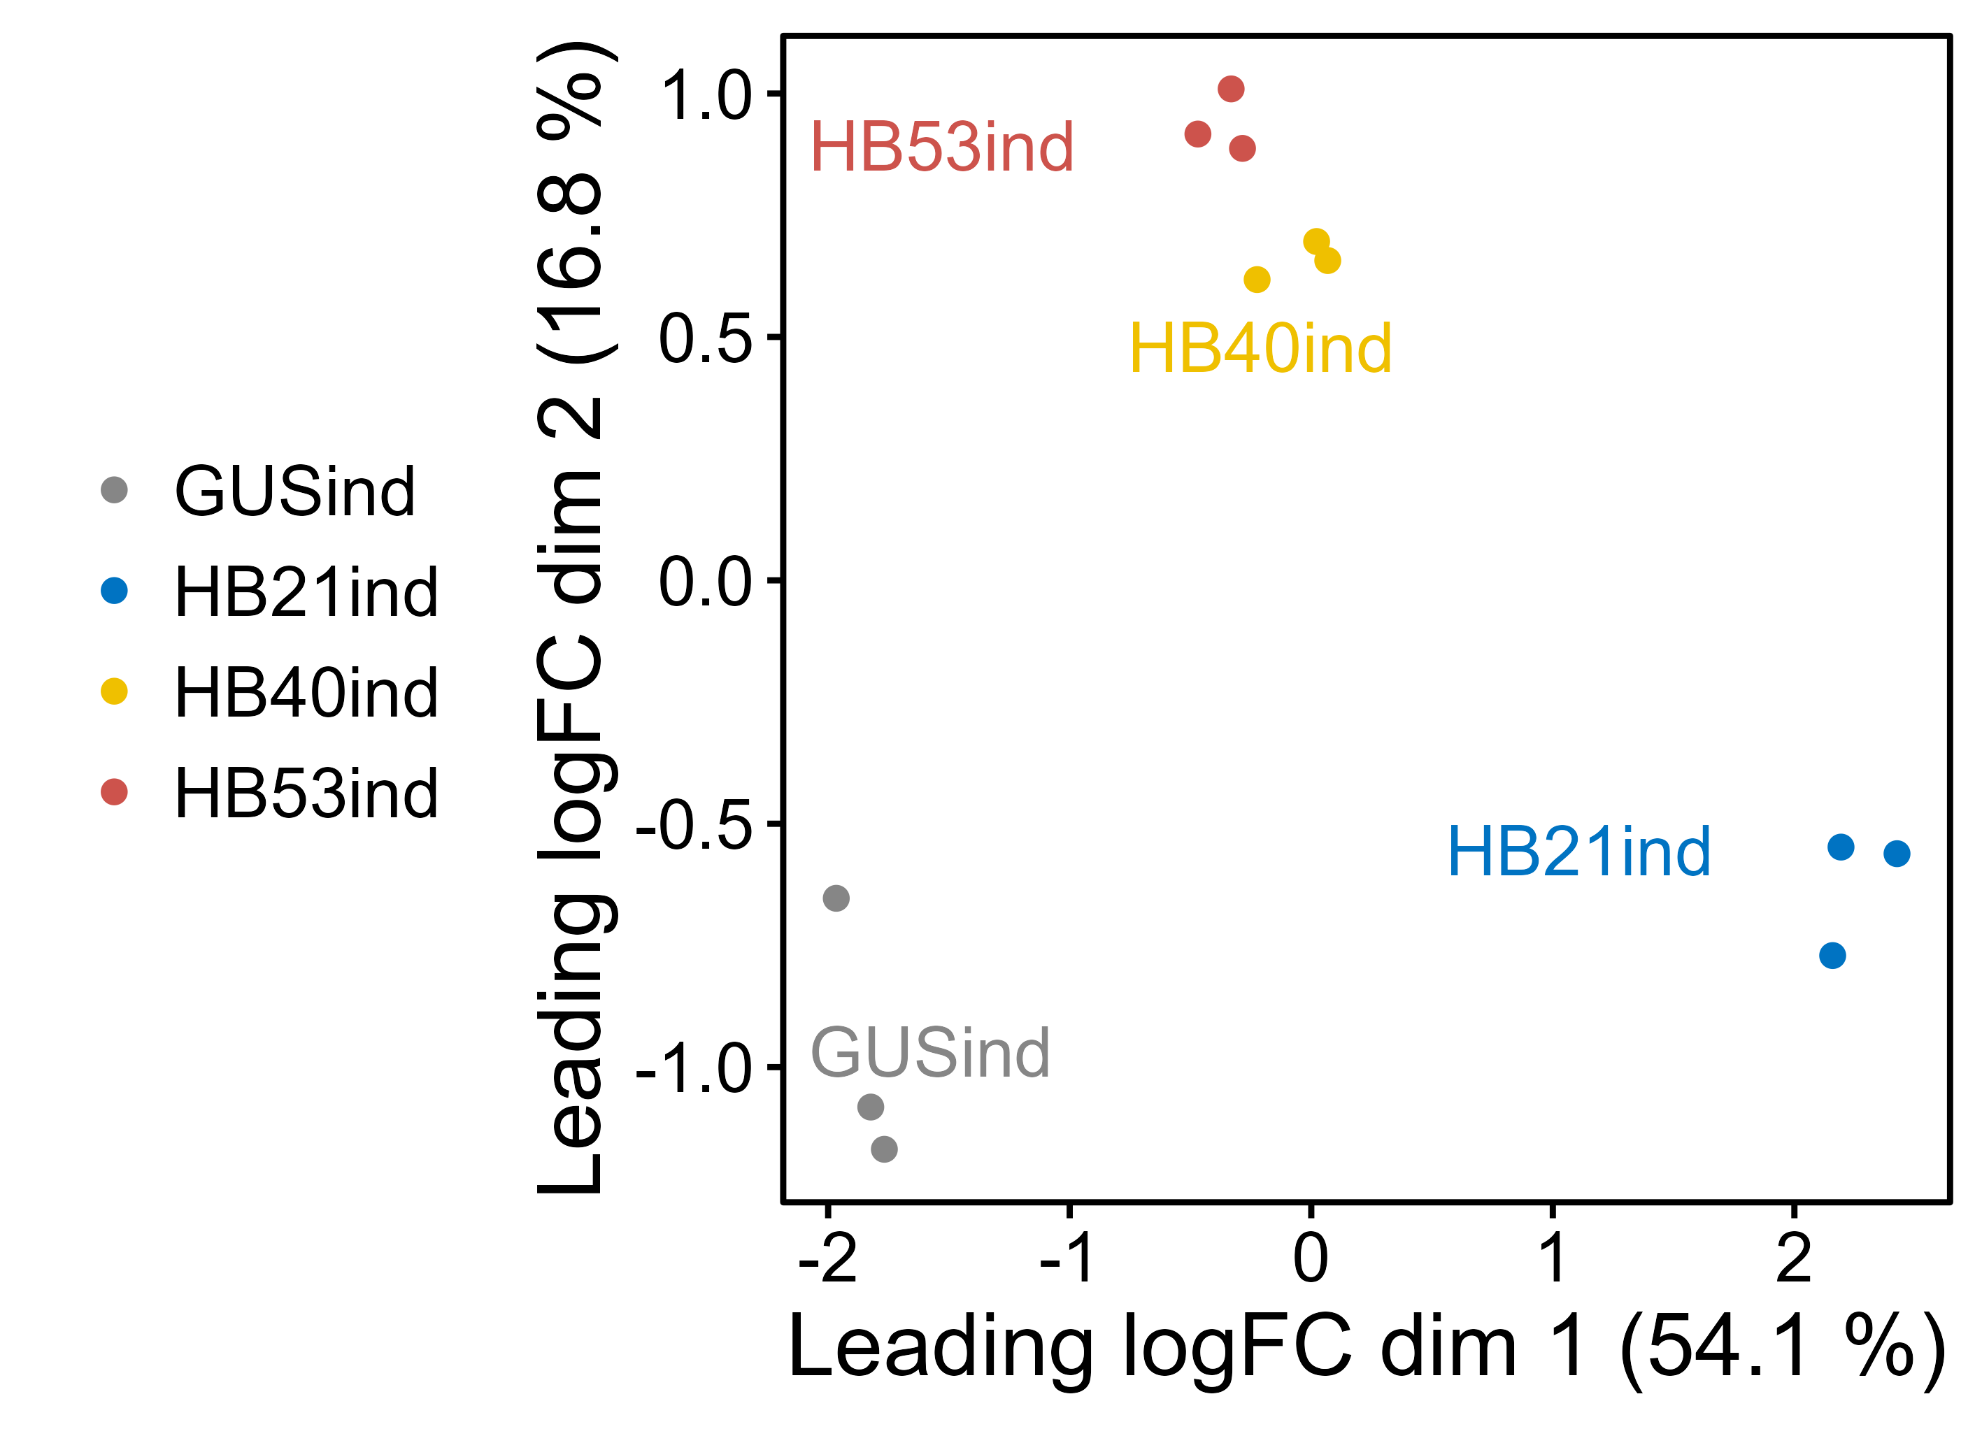

Slide 3
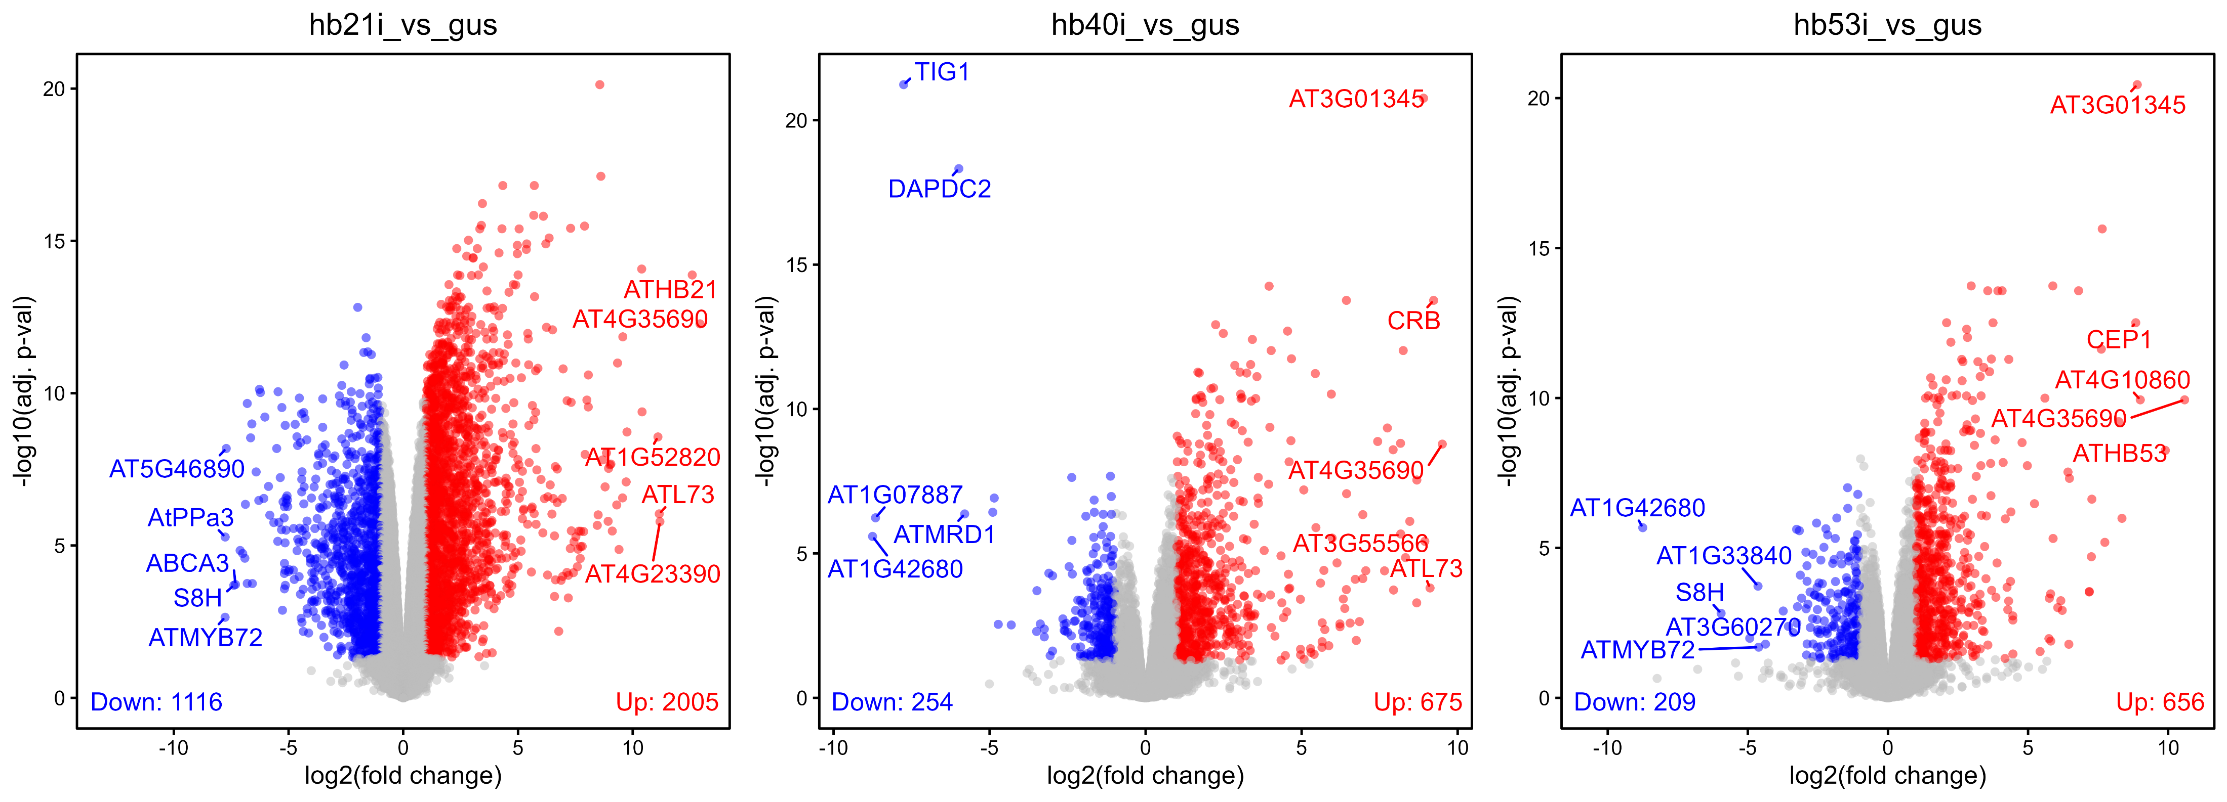

Slide 4
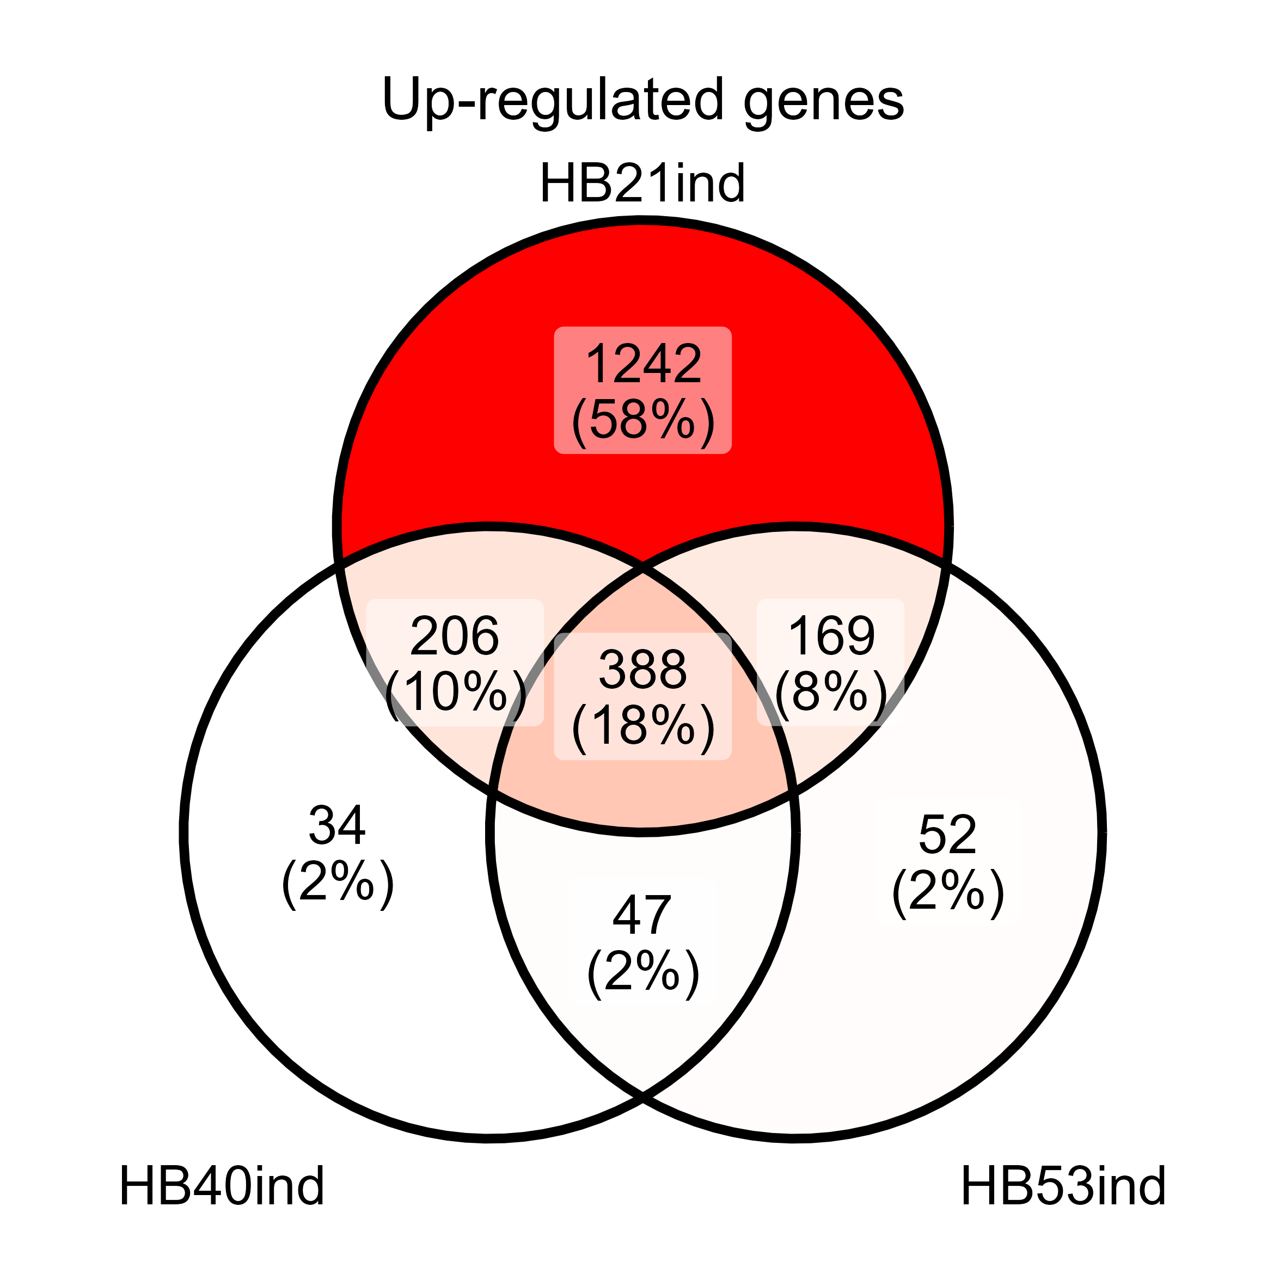
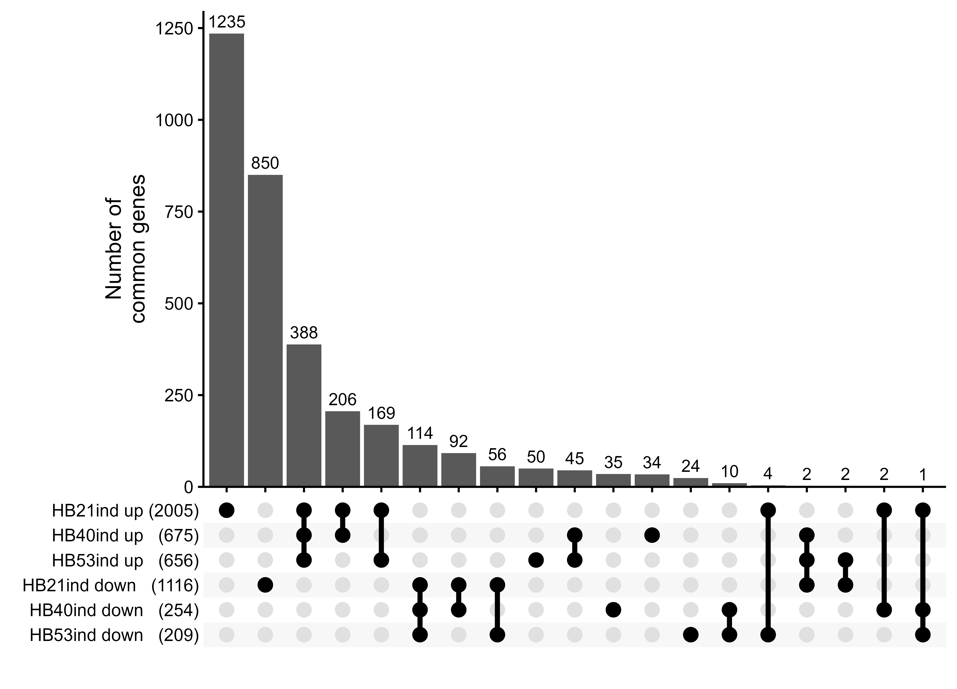
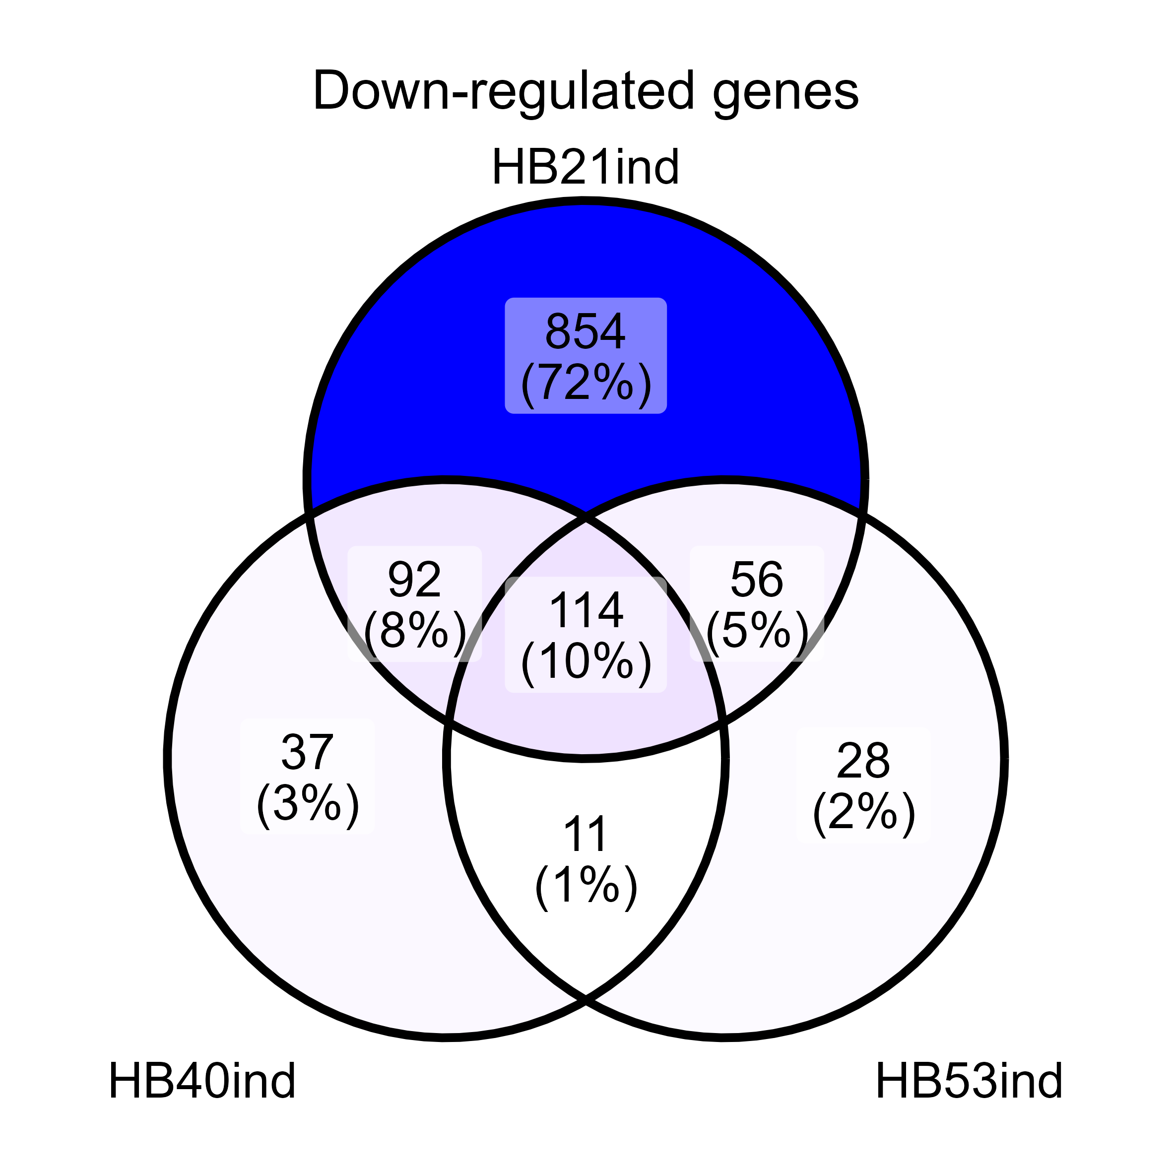
Overlap between HB-regulated genes

Slide 5
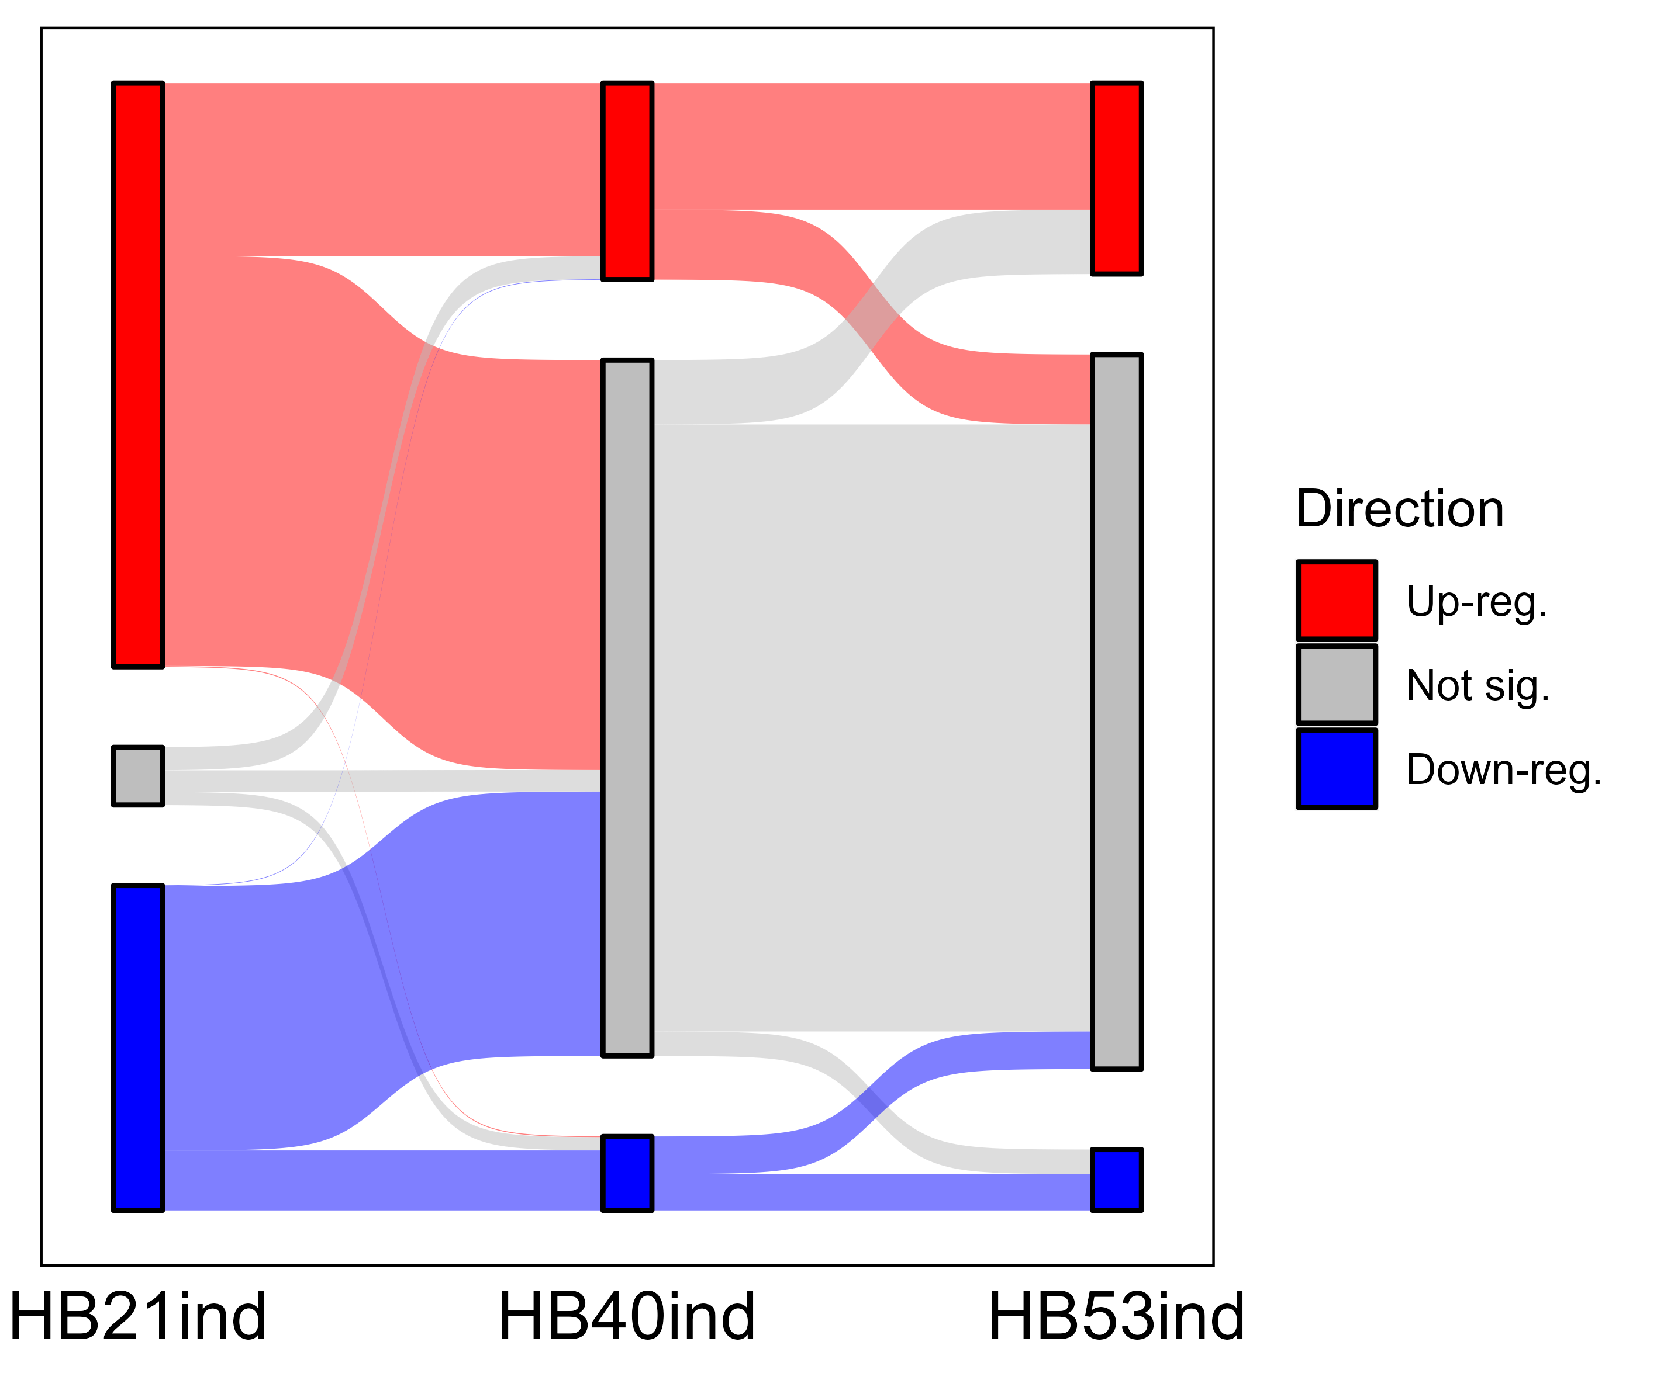
“Sankey plot”, visually nice, but not very informative

Slide 6
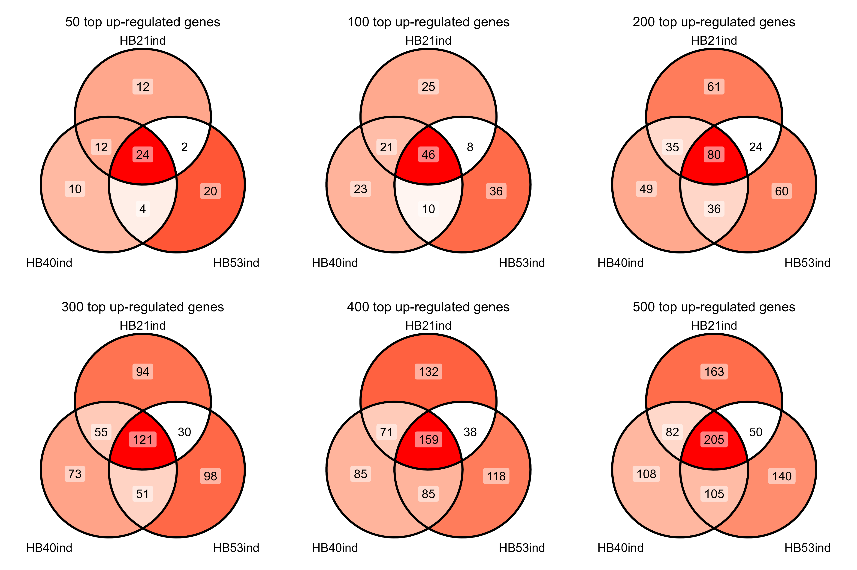

Slide 7
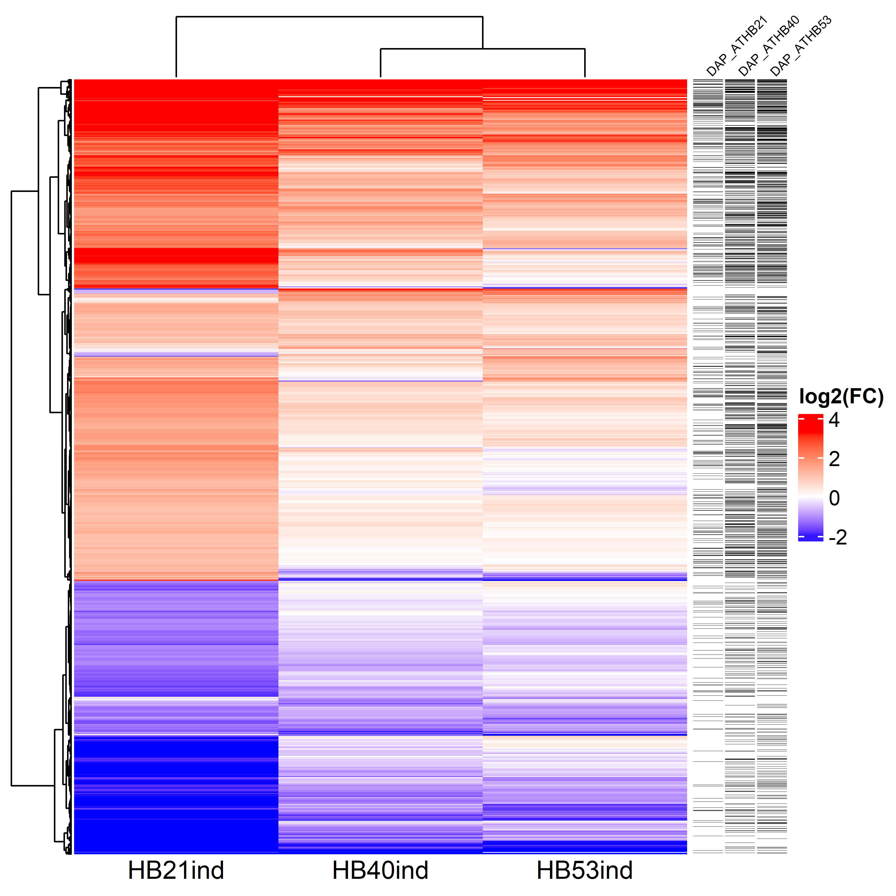

Slide 8
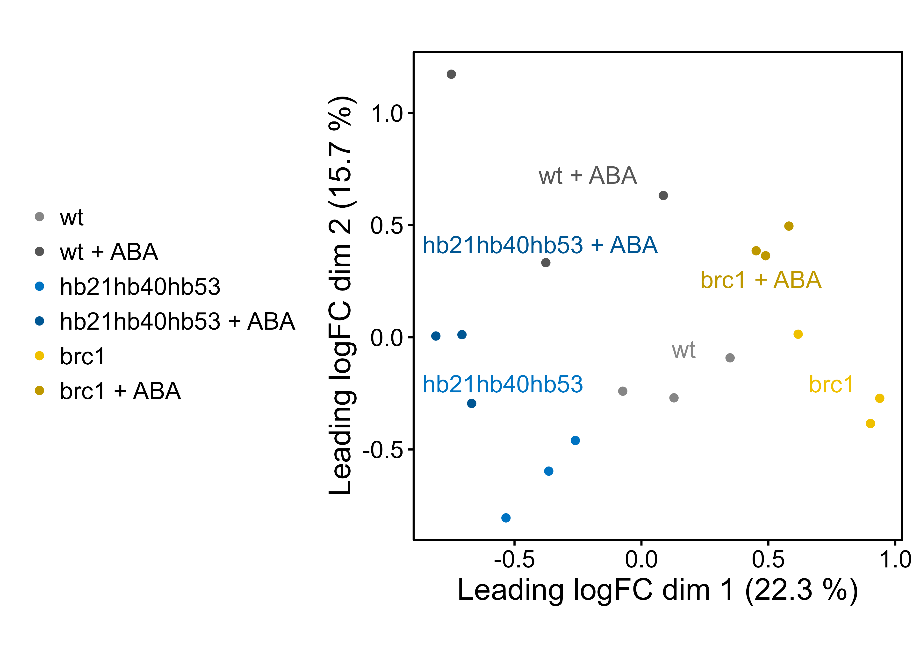
Low-expressed genes filtered by average RPKM < 1

Slide 9
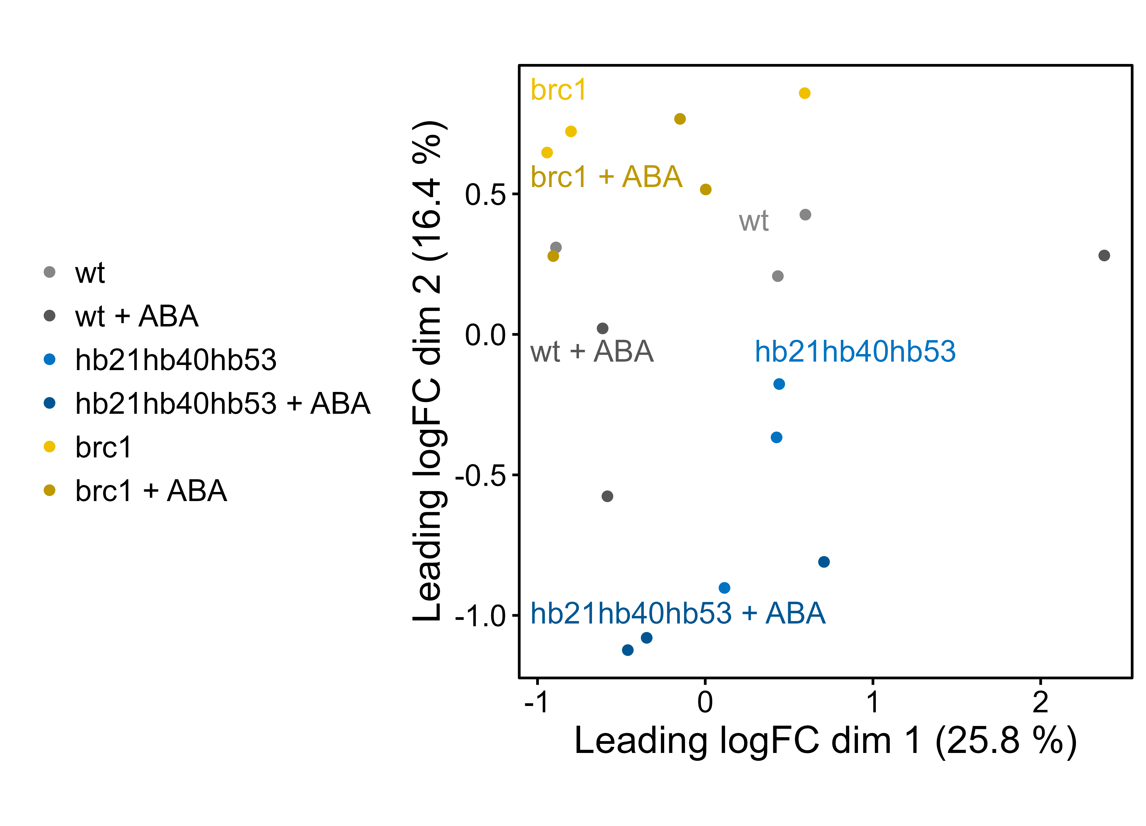
Low-expressed genes filtered by edgeR function filterByExpr

Slide 10
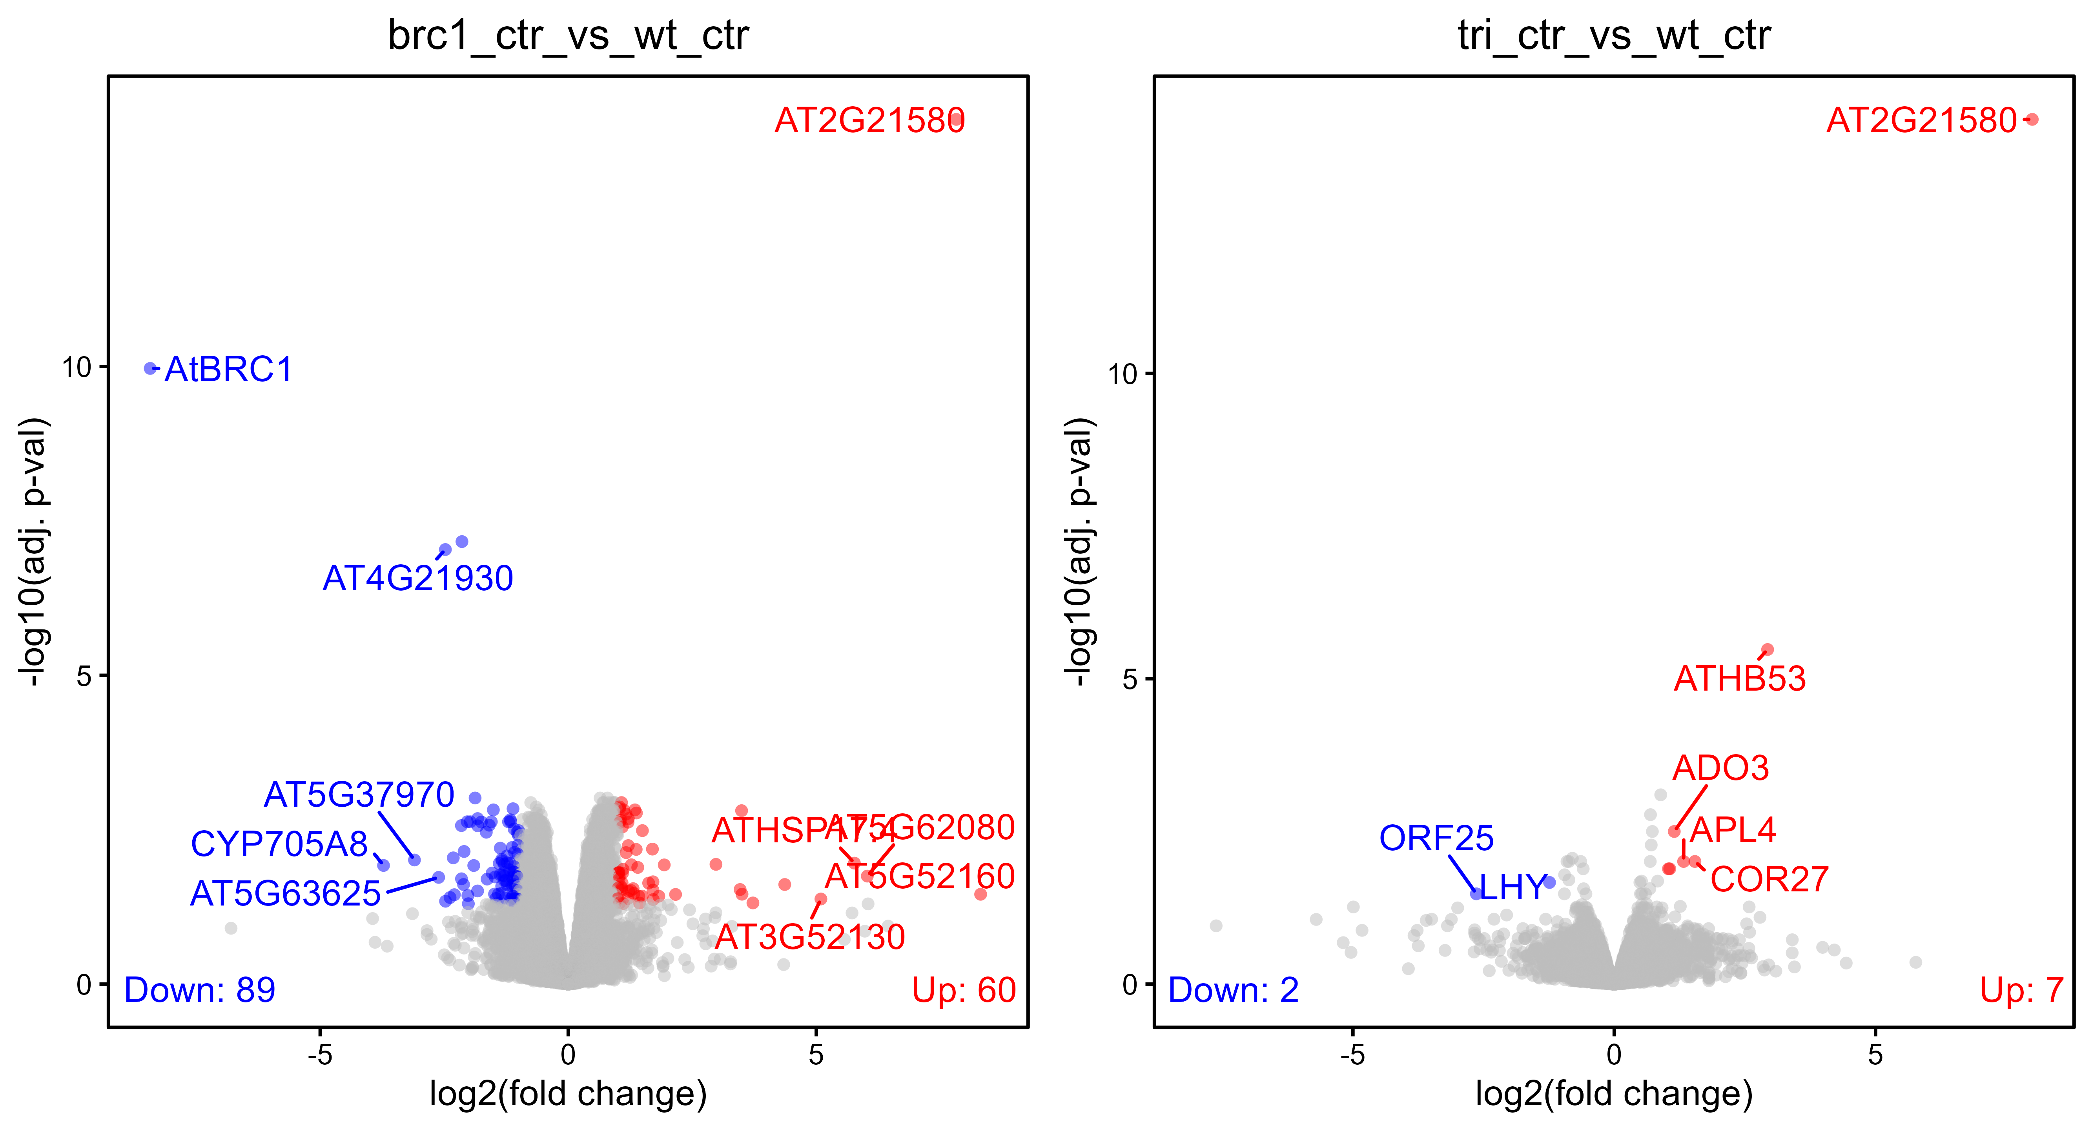
Low-expressed genes filtered by average RPKM < 1

Slide 11
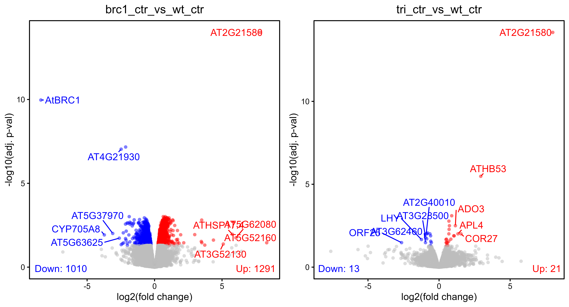
Low-expressed genes filtered by average RPKM < 1

Slide 12
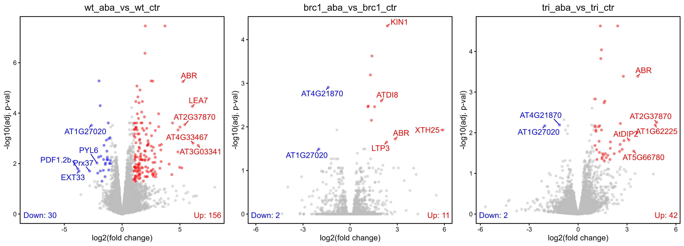
Low-expressed genes filtered by average RPKM < 1

Slide 13
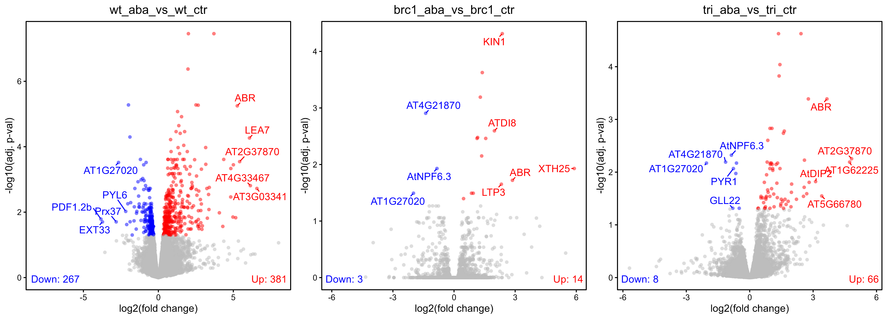
Low-expressed genes filtered by average RPKM < 1

Slide 14
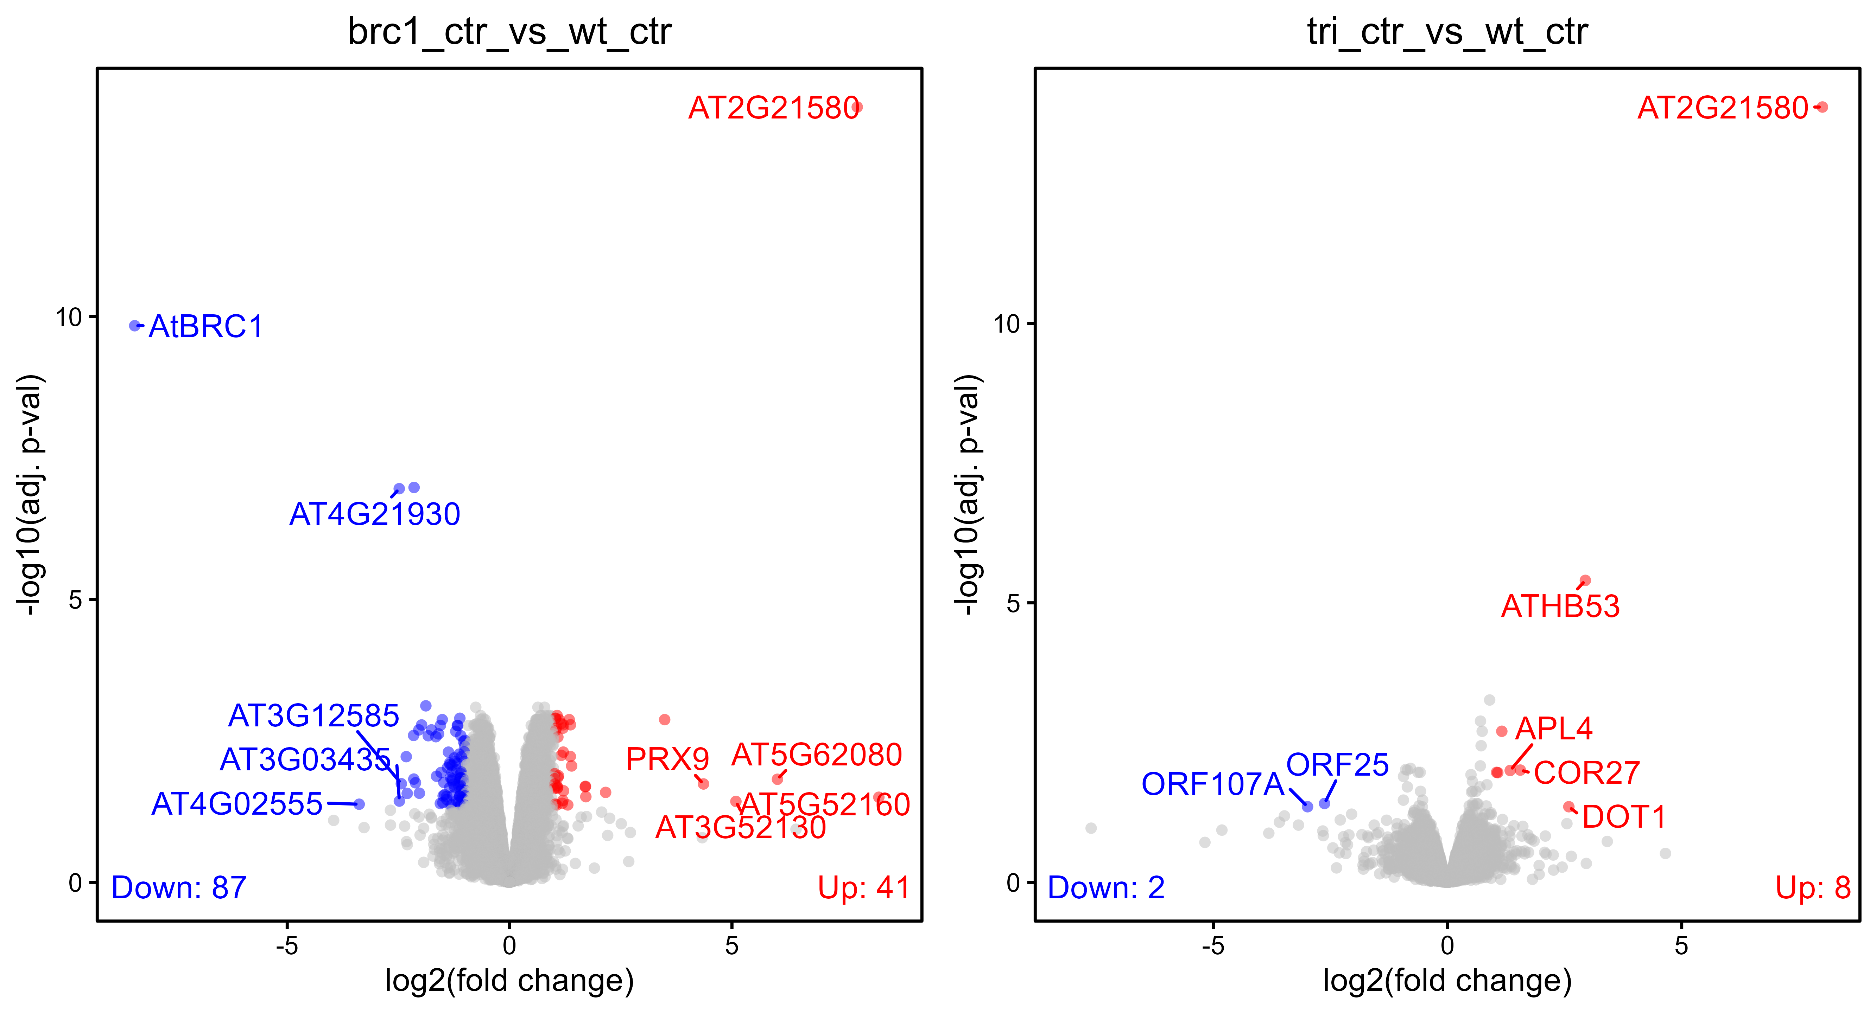
Low-expressed genes filtered by edgeR function filterByExpr

Slide 15
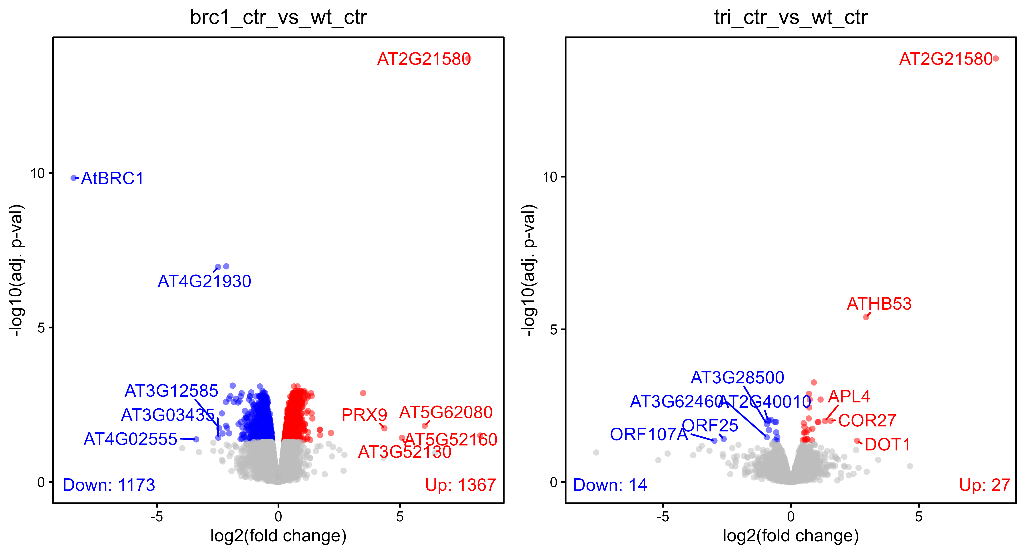
Low-expressed genes filtered by edgeR function filterByExpr

Slide 16
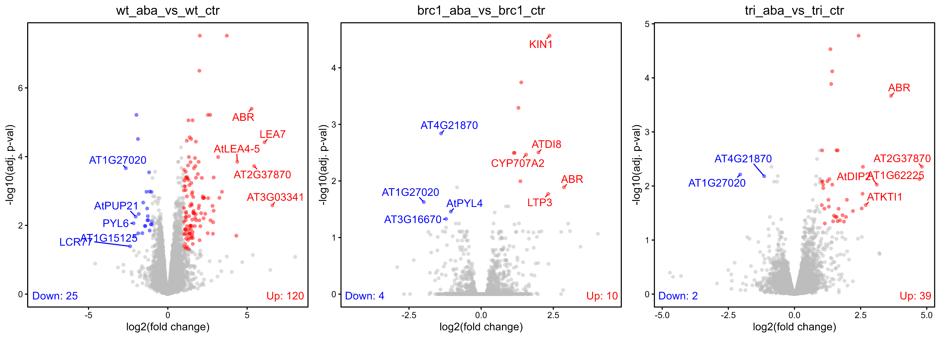
Low-expressed genes filtered by edgeR function filterByExpr

Slide 17
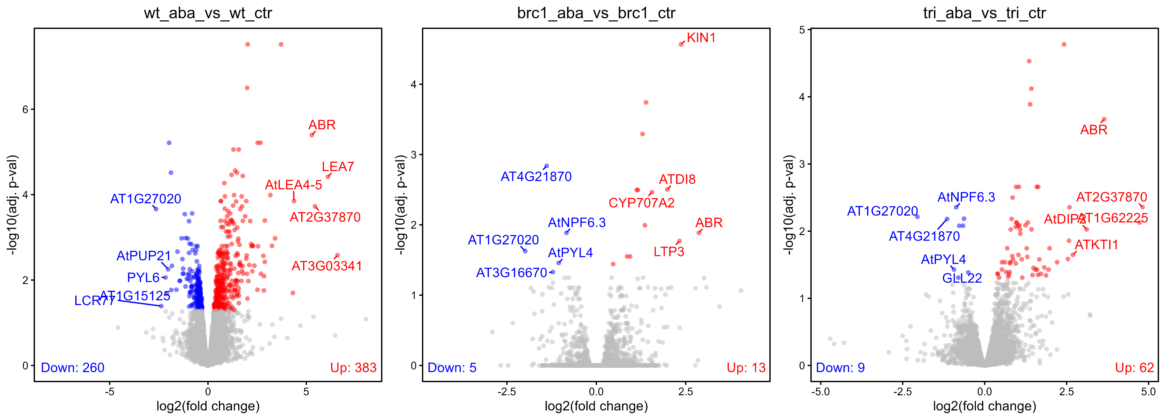
Low-expressed genes filtered by edgeR function filterByExpr

Slide 18
Why wt-ABA-responding genes do not change in brc1 and (to some extent) in hb21hb40h53
1- Check if these genes are already up-/down-regulated in brc1 mutants so they do now show an increase/decrease in response to ABA.
2- Are these genes expressed at very low levels -> they have high variability in expression -> high FDR -> not significantly differentially expressed ?
3-

Slide 19
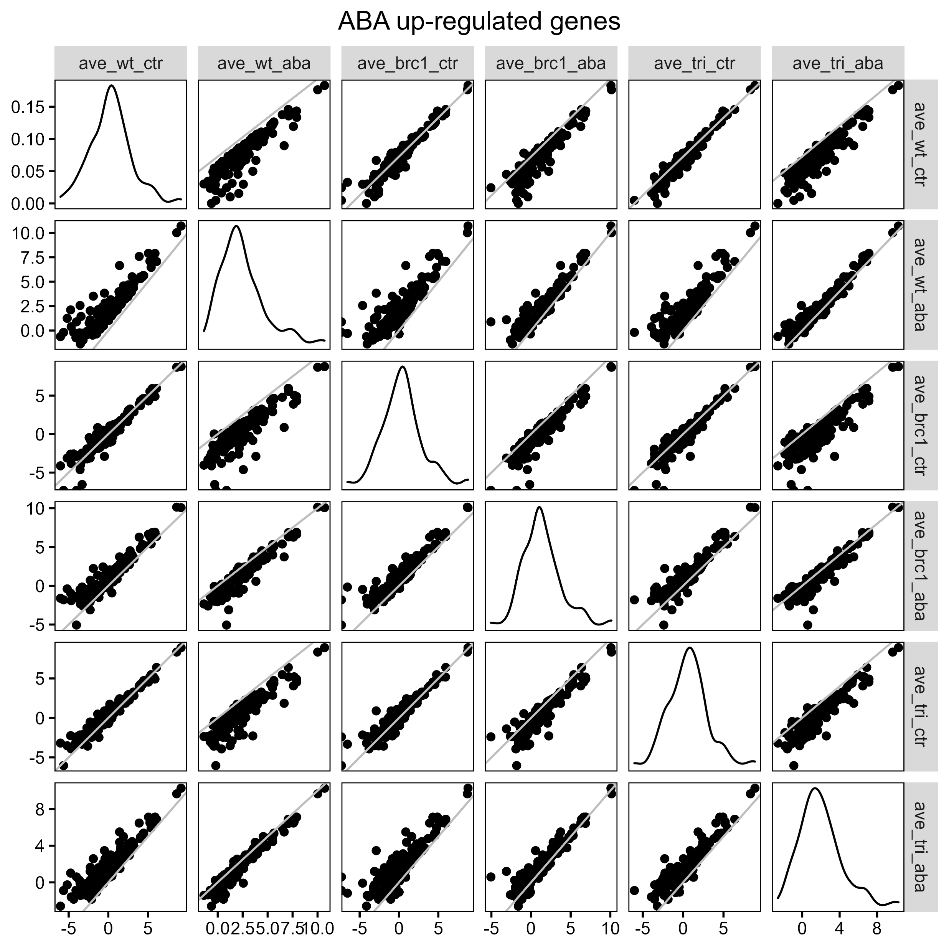
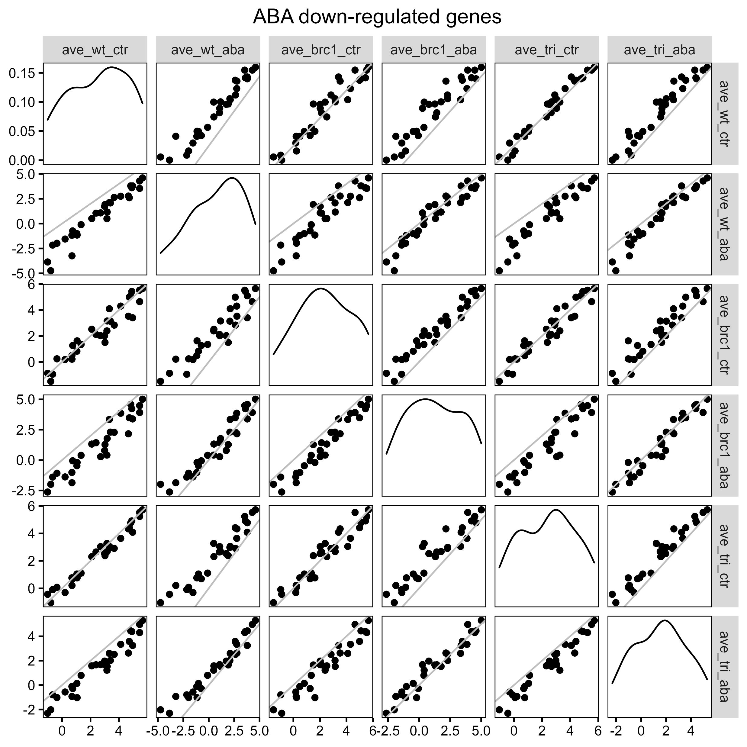
Average RPKM values of wt-ABA-responding genes (FC>2)

Slide 20
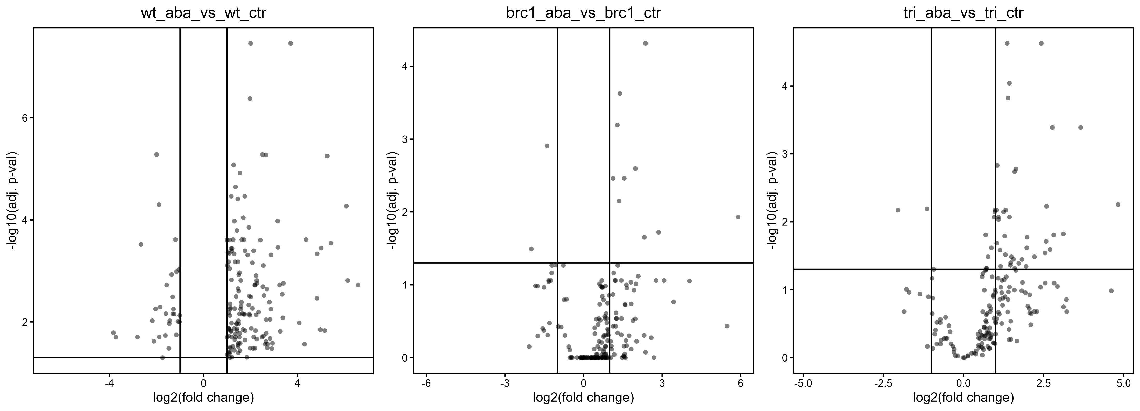

Slide 21
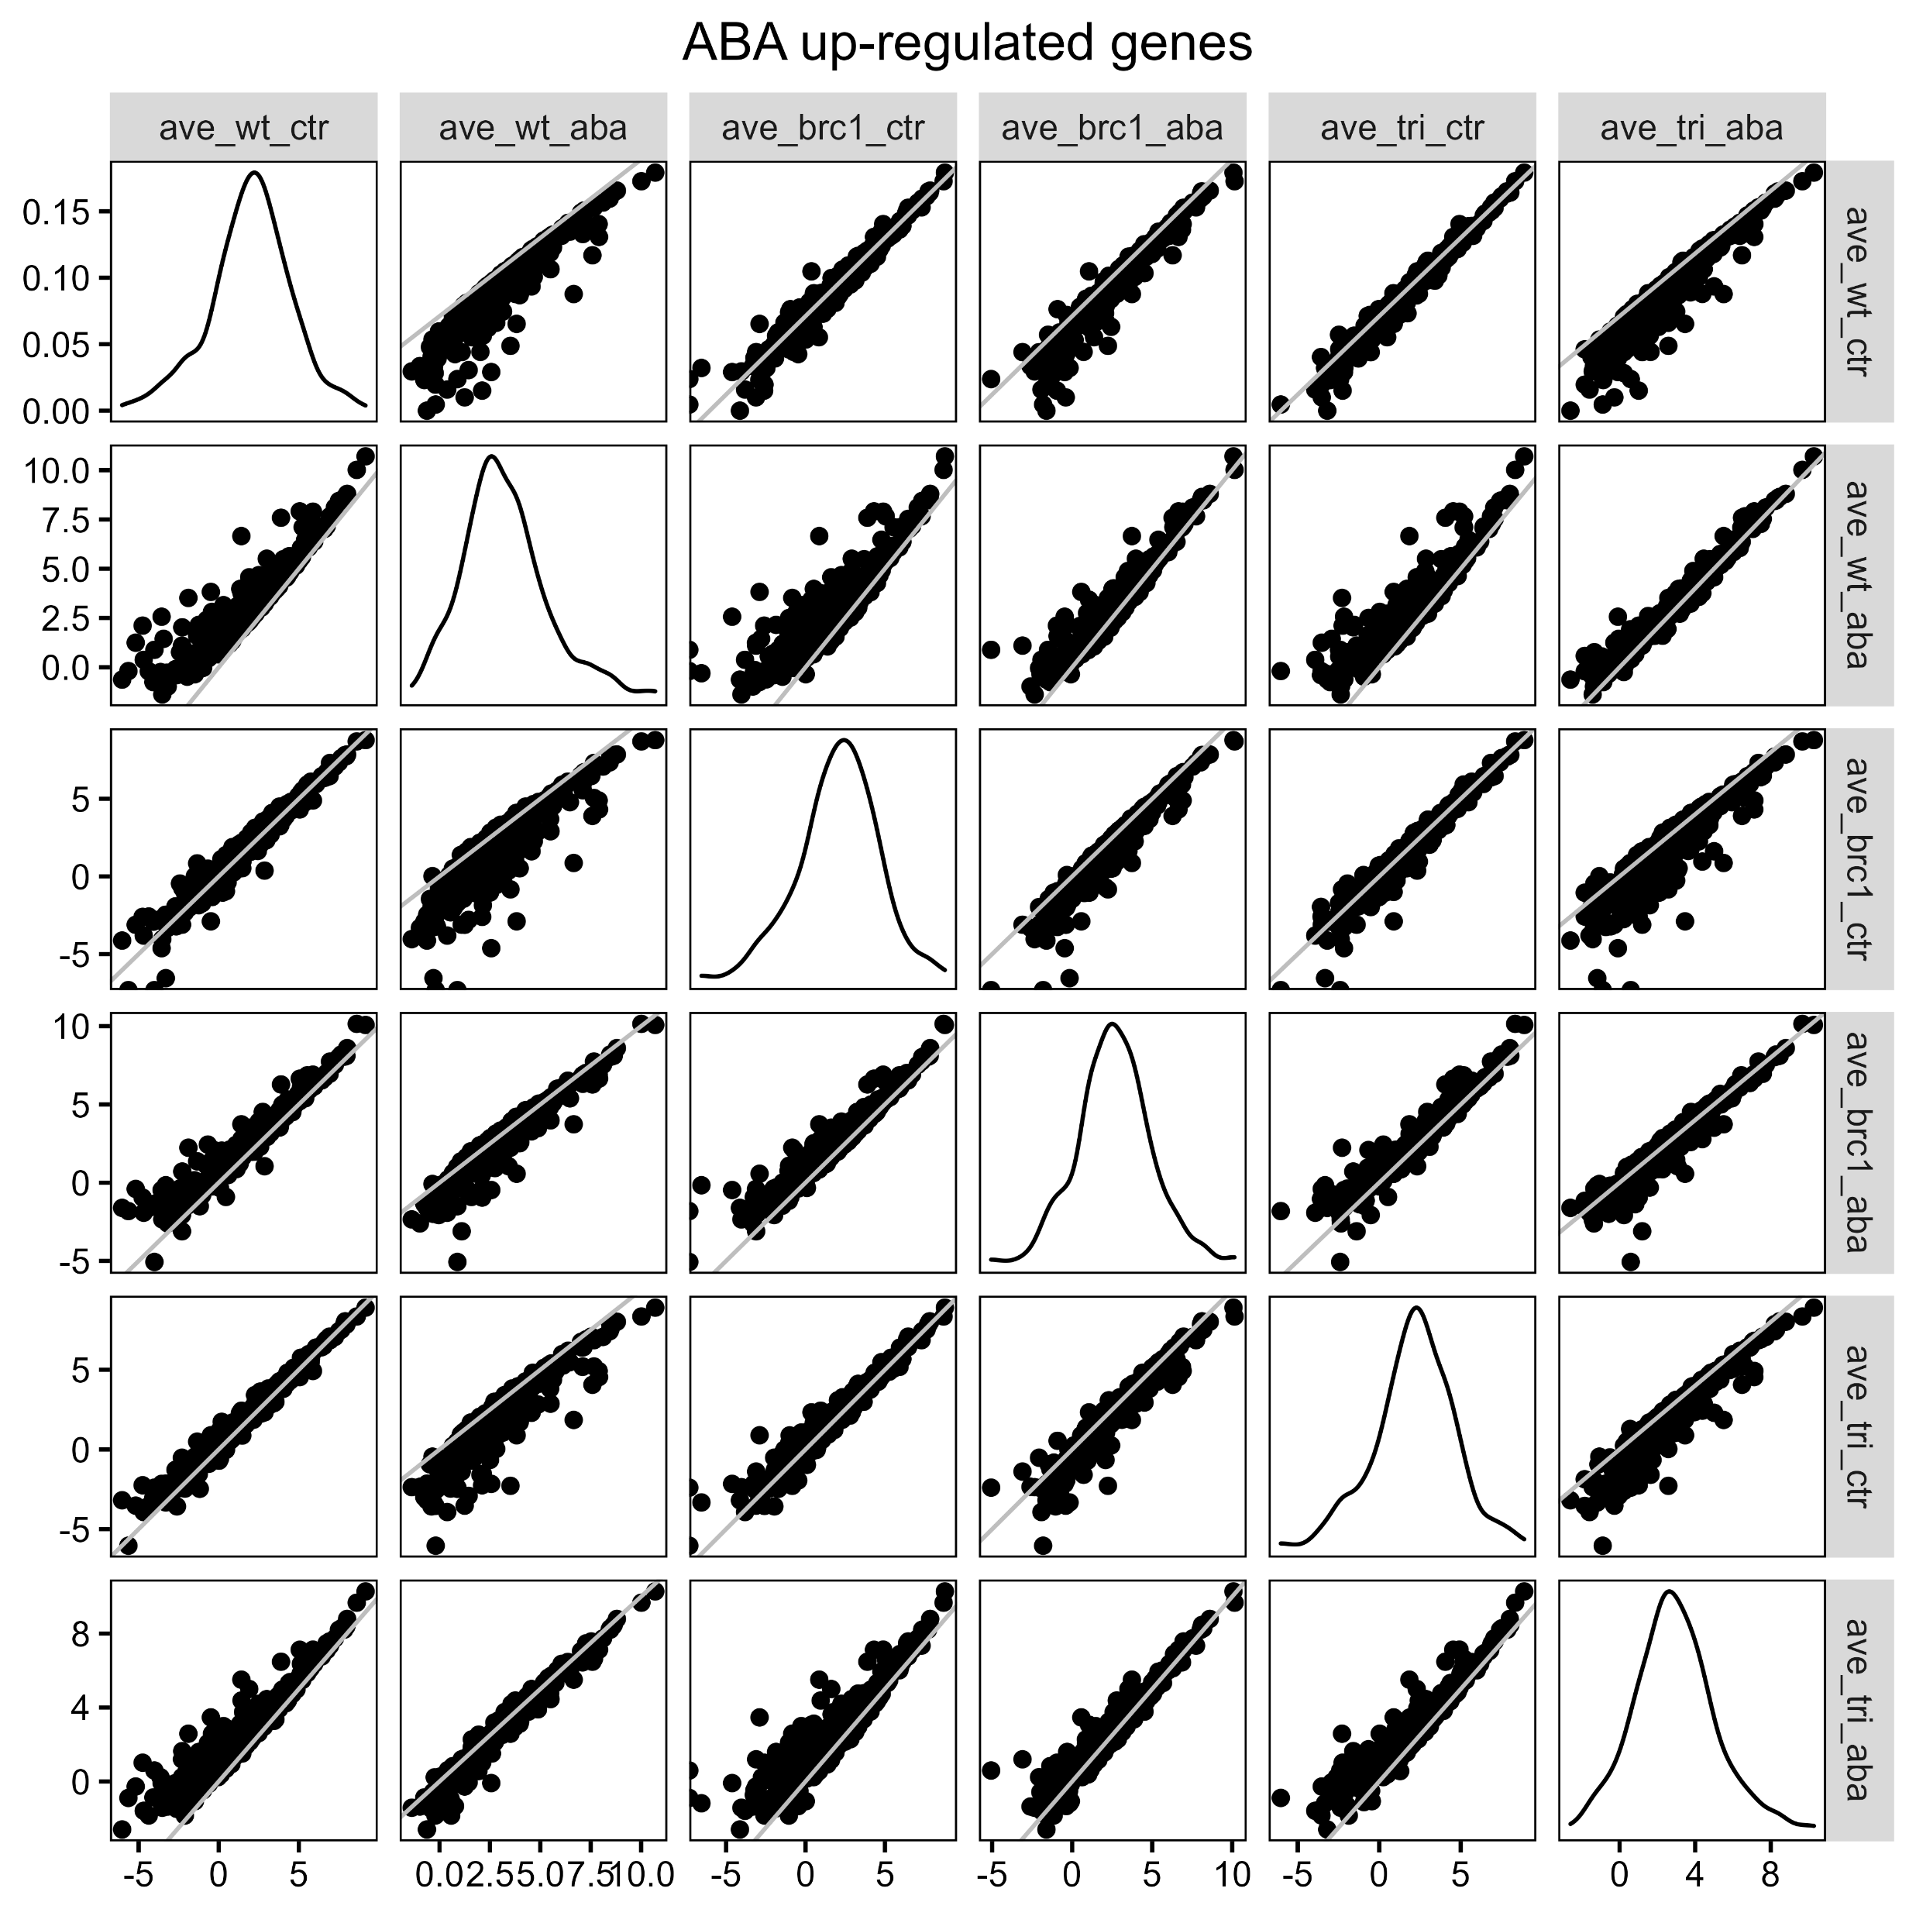
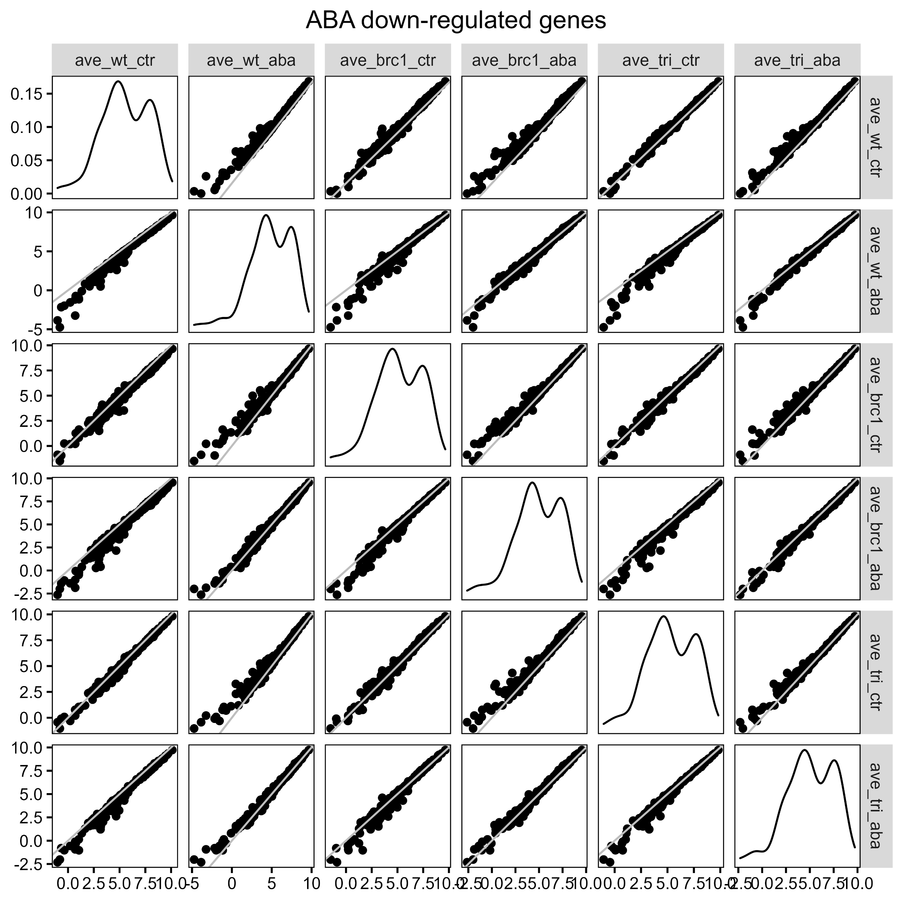

Slide 22
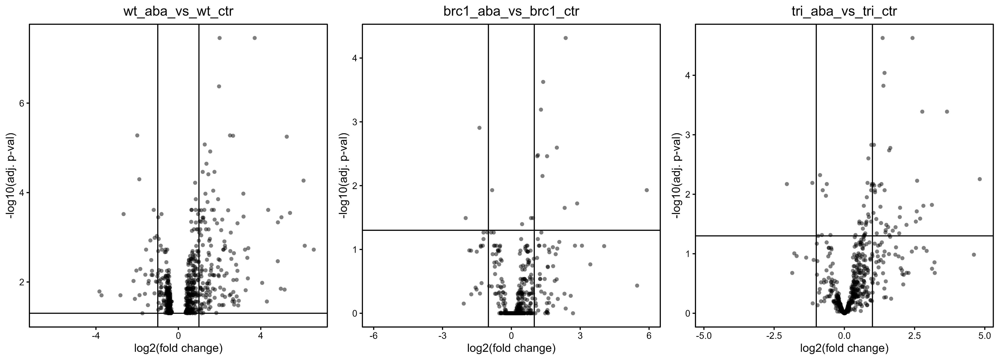

Slide 23
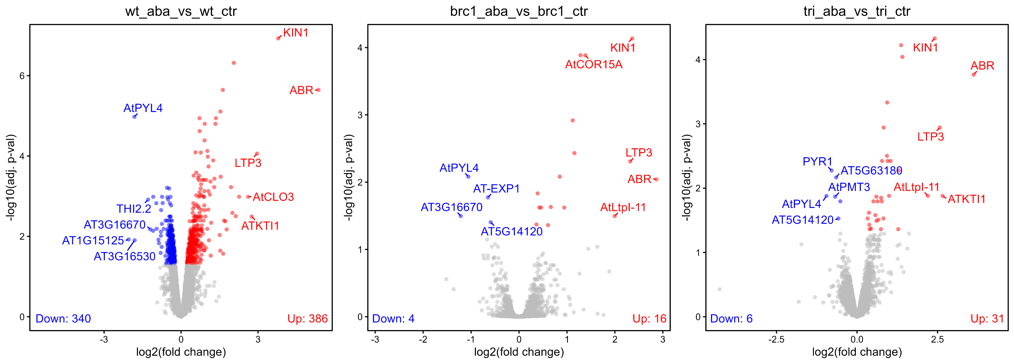
Removing genes with low expression across all samples (average RPKM across all samples < 10)
To check if genes with very low FDR in brc1 are wt-ABA-responding (they are not)

